Slide 1
Parameter Selection in
Particle Swarm Optimization
Yuhui Shi and Russell C. Eberhart
Department of Electrical Engineering
Indiana University Purdue University Indianapolis
Presenter: Tsung-Jung Tsai (蔡宗容)
Date: Nov. 14, 2007

Slide 2
Abstract
In this paper, the authors first analyze the impact that the inertia weight(慣性權重) and maximum velocity have on the performance of the particle swarm optimizer, and then provide guidelines for selecting these two parameters. Analysis of experiments demonstrates the validity of these guidelines.
Notes:
不同於傳統搜尋演算法，演化計算技巧在搜尋空間中尋找具有潛在解的族群。
當這些技巧應用於複雜的最佳化問題中，經由潛在解之間的合作與競爭，經常可以很迅速的找出最佳值。
最普遍使用的以族群為基礎的演化計算技巧是經由自然演化所激發出來。
四個知名的例子是基因演算法(genetic algorithms)、基因規劃(genetic programming)、演化規劃(evolutionary programming)及演化策略(evolutionary strategies) 。
不同於這些演化所激發出的演化計算技巧，一個新的演化計算技巧稱為PSO，是由社會行為的模擬所激發出來。

Slide 3
Introduction of PSO
A new evolutionary computation technique is motivated from the simulation of social behavior.
Designed and developed by Eberhart and Kennedy.
Use to find an optimal region
Notes:
● 粒子群最佳化演算法是Kennedy和Eberhart於1995年時提出，在研究PSO的過程中，有各種不同版本出現 [4-9]，也有收斂及最佳參數選定的探討文獻 [10-11]。PSO的概念源自群體行為理論，啟發自觀察鳥群或魚群行動時，能透過個體間特別的訊息傳遞方式，使整個團體朝同一方向、目標而去，是模仿此類生物行為反應來尋求完成群體最大利益的方法。PSO的基本演算模式如下：首以均勻分佈(uniform distribution)隨機產生初始粒子群，每一個粒子都是一個求解問題的侯選解，粒子群會參考個體的最佳經驗，以及群體的最佳經驗，選擇修正的方式，經過不斷的修正之後，粒子群會漸漸接近最佳解。
Reference: http://www.im.ncnu.edu.tw/new/html/now_info/doc/doc/First_FanBen.doc
● 粒子群優法(PSO)是一種模擬社會群體活動行為之智慧演算法，學者Eberhart和Kennedy藉由觀察鳥群飛行與魚群在水中移動的運動規律，在1995年發表關於鳥、魚群覓食行為的粒子群優演算方法。
在粒子群最佳化(optimization)方法中，每一個個體稱為粒子，且每個粒子有各自經驗，經由經驗交換，使得每個粒子能往距離食物點較近的路徑飛去。
Reference: http://210.71.15.19/download2/jjyan/951-Seminar%20¤W½Ò¸ê®Æ/®Ñ³ø°Q½×¸ê®Æ/±iÀ¹©ú_À³¥Î²É¤l¸sÀuªk©óFIRÂø°T.ppt

Slide 4
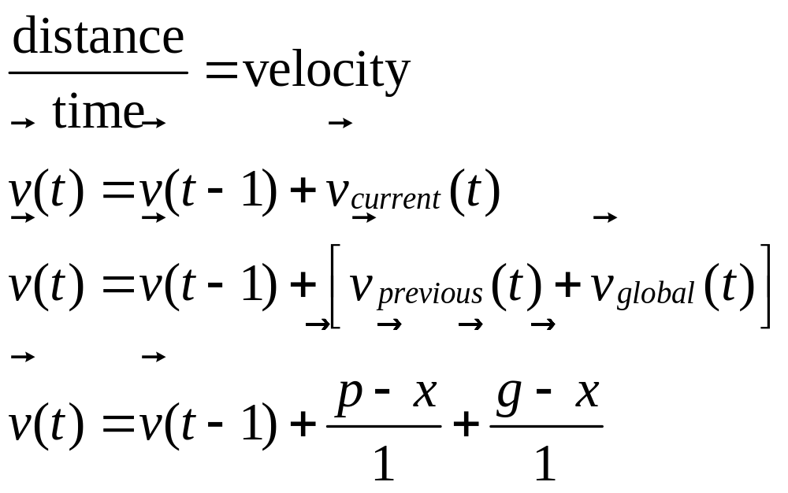
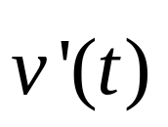
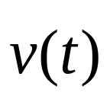
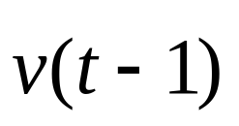
Basic principles of PSO (1/2)

Slide 5
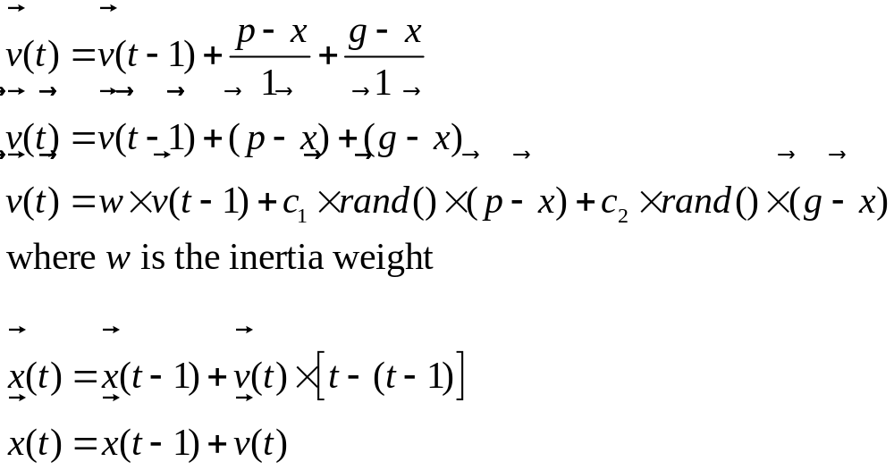
Basic principles of PSO (2/2)
Notes:
變速度公式根據粒子先前的速度、及它目前所在位置離它過去最好的經驗與族群的最好經驗之間的各自距離，來計算粒子的新速度。然後粒子飛向一個新位置。每個粒子的效能是根據前先定義的適應函數來測量。

Slide 6
Standard PSO Algorithm
/* Repeat PSO cycle for InterationLimit times */
for( step = 0; step < IterationLimit; step++ ) {
for( i = 0; i < PopulationSize; i++ ) {
for( d = 0; d < Dimension; d++) {
adjust ω
V^{d}_{i}(t+1) = ωV^{d}_{i}(t) + c₁r_{1,t}(P^{d}_{i local} – X^{d}_{i}(t) ) + c₂r_{2,t}(P_{global} – X^{d}_{i}(t) )
X^{d}_{i}(t+1) = X^{d}_{i}(t) + V^{d}_{i} (t+1)
calculate fitness
update P^{d}_{i local}、P_{global}
}
}
}

Slide 7
The trade-off between global and local exploration abilities
The inertia weight ω is employed to control the impact of the previous velocities on the current velocity.
A larger inertia weight w facilitates global exploration (searching new areas).
A smaller inertia weight tends to facilitate local exploration to fine-tune the current search area.
Notes:
區域與廣域求解空間中，探索能力的抉擇。

Slide 8
A suitable inertia weight ω
Can provide a balance between global and local exploration abilities
Require less iterations on average to find the optimum

Slide 9
Analysis (1/3)
An inertia weight in the range [0.9, 1.2] on average has a better performance.
A time decreasing inertia weight from 1.4 to 0 is found to be better than a fixed inertia weight.
The large inertia weights at the beginning help to find good seeds.
the later small inertia weights facilitate fine search.
Notes:
PSO的慣性權重位於區間 [0.9, 1.2]，實驗發現在平均上有較佳的效能。換言之，它有較大的機會在合理的疊代次數中發現全域最佳值。
隨著時間的過去，將慣性權重從 1.4 逐漸降低到 0 ，可以發現到比固定慣性權重來的更好。這是因為大的慣性權重在一開始時，能幫助找到好的搜尋起始種子，以及後來的較小的權重促進較好的搜尋。

Slide 10
Analysis (2/3)
Setting a too small maximum velocity
=> global exploration ability is limited
=> always favor a local search no matter
what the inertia weight is
Setting a large maximum velocity
=> have a large range of exploration ability

Slide 11
Analysis (3/3)
A way to do that is to delete maximum velocity allowed in the algorithm implementation.
And allow inertia weight itself to control exploration ability

Slide 12
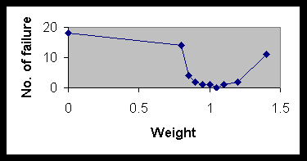
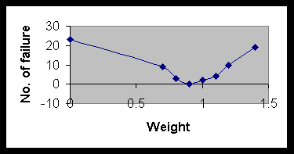
Figure 1 Number of failures vs. inertia weights. Vmax=2
Figure 1 Number of failures vs. inertia weights. Vmax=3

Slide 13
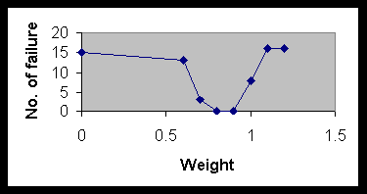
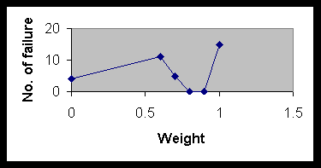
Figure 3 Number of failures vs. inertia weights. Vmax=4
Figure 4 Number of failures vs. inertia weights. Vmax=5

Slide 14
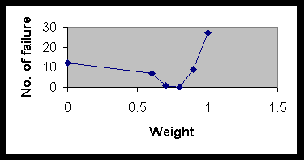
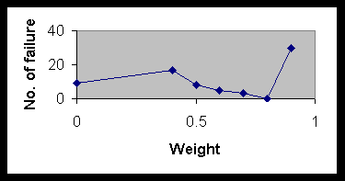
Figure 5 Number of failures vs. inertia weights. Vmax=10
Figure 6 Number of failures vs. inertia weights. Vmax=Xmax

